Slide 1
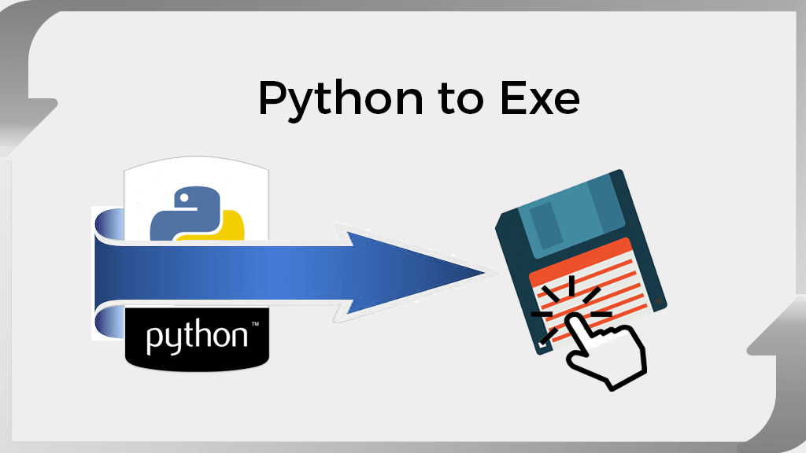
How to convert .py file to .exe

Slide 2
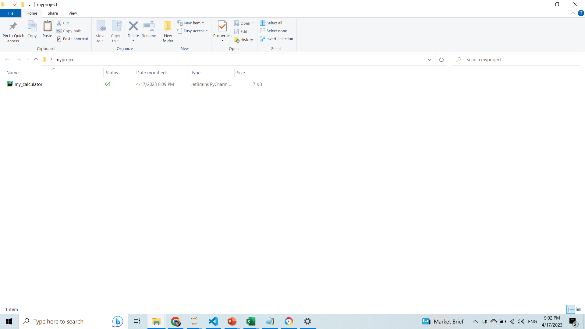
Open your folder where you have your .pyfile. In our case our folder name is myproject.

Slide 3
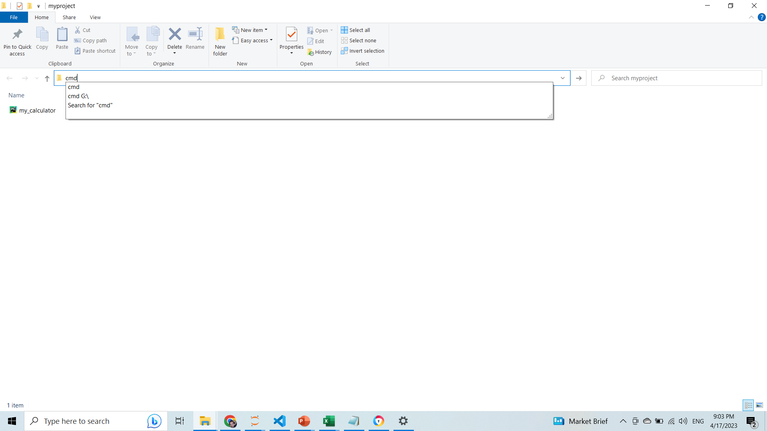
Now open cmd in same folder in which you have your .py file

Slide 4
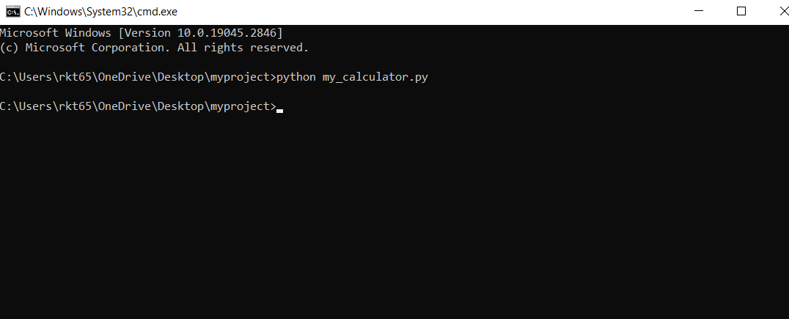
Lets run our .py file…………………….
We have .py file in the name of my_calculator.py in our my_project folder.Lets run it one with the help of cmd.

Slide 5
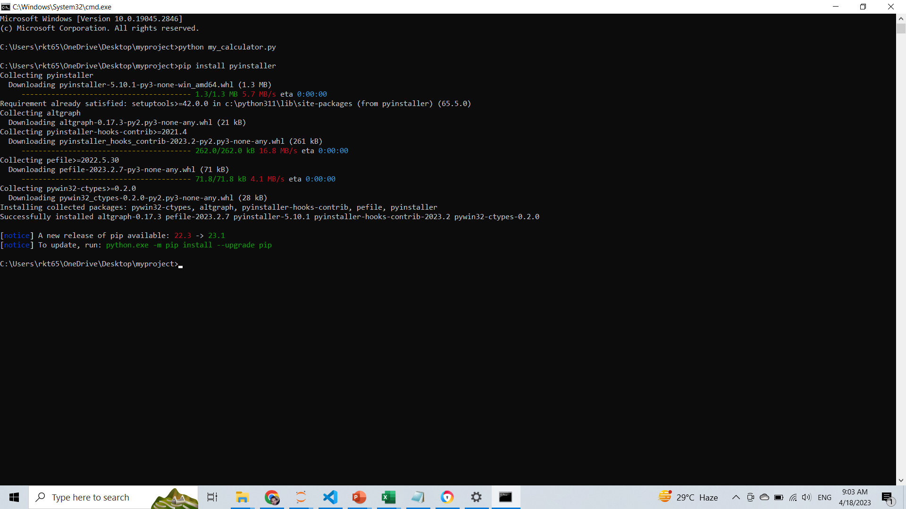
Now we need to install pyinstaller and we are going to install it with the help of cmd. Type : pip install pyinstaller

Slide 6
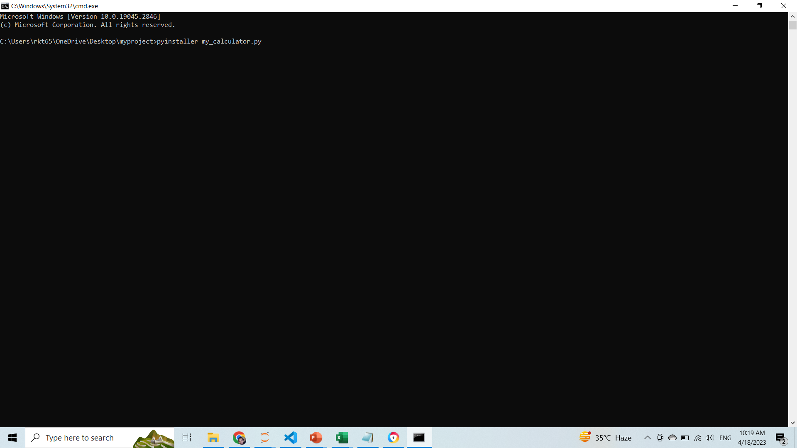
Now we will run a command…. pyinstaller yourfile.py after that hit Enter. See below…

Slide 7
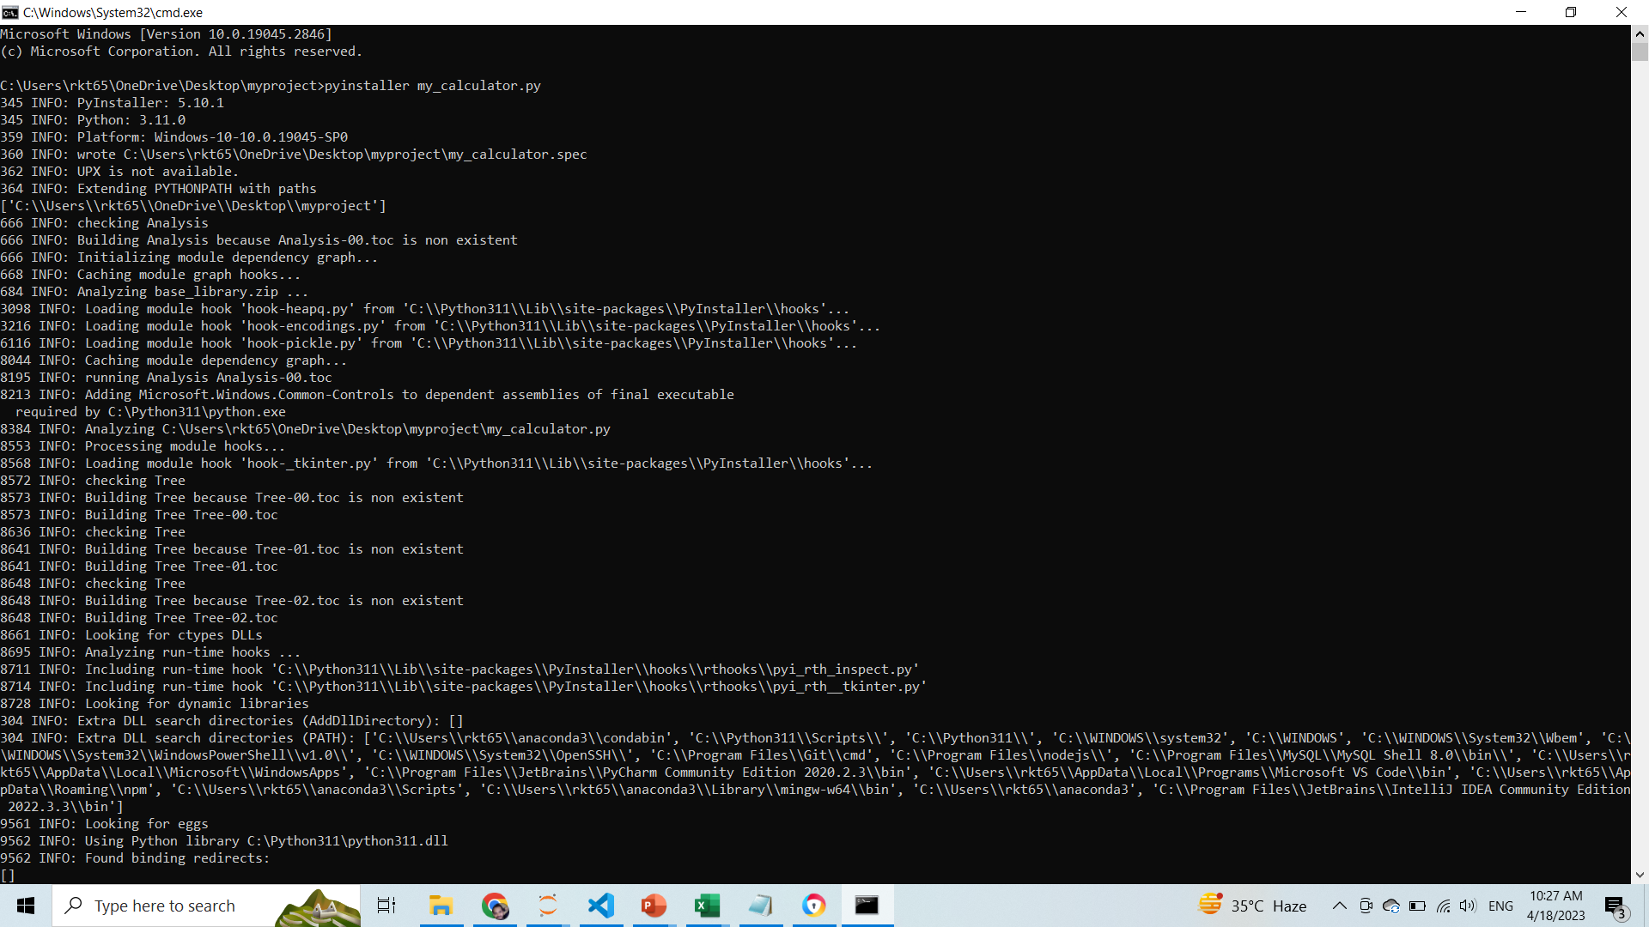

Slide 8
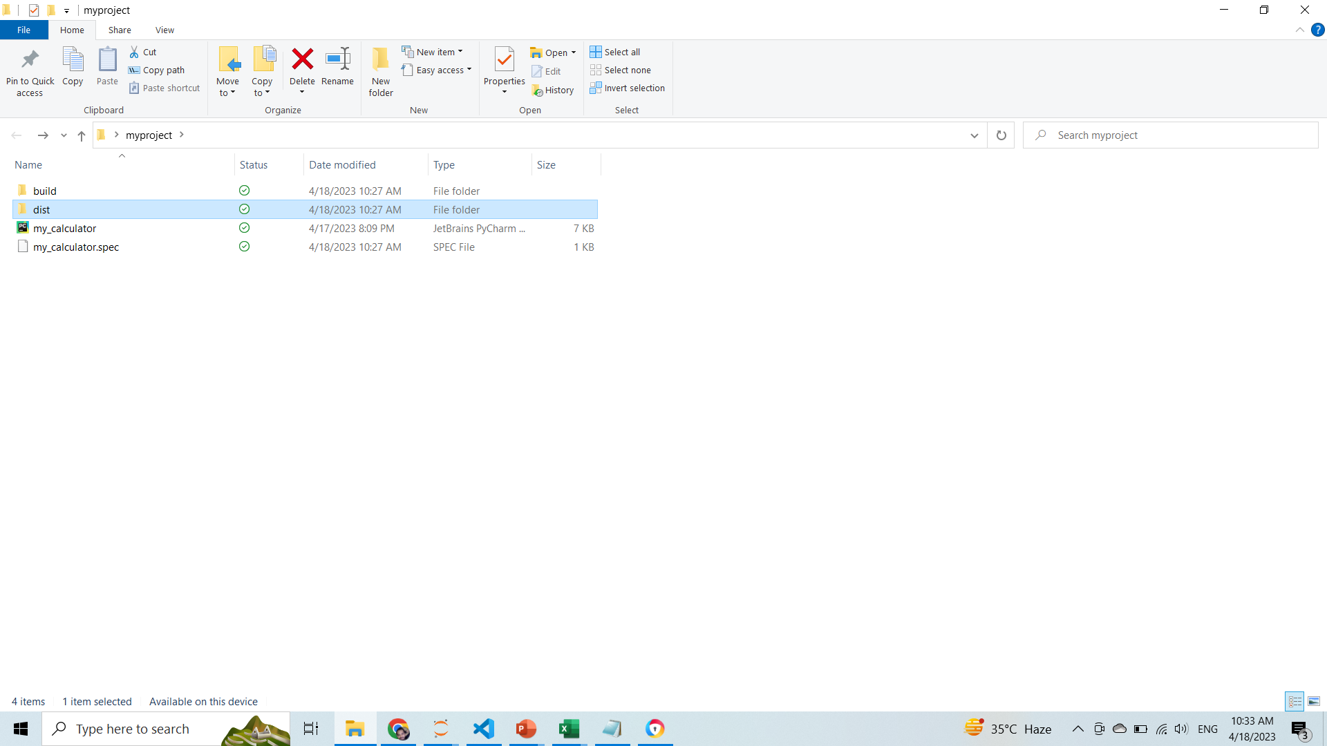
As you can see it will create three files. You can find your .exe file in dist folder.

Slide 9
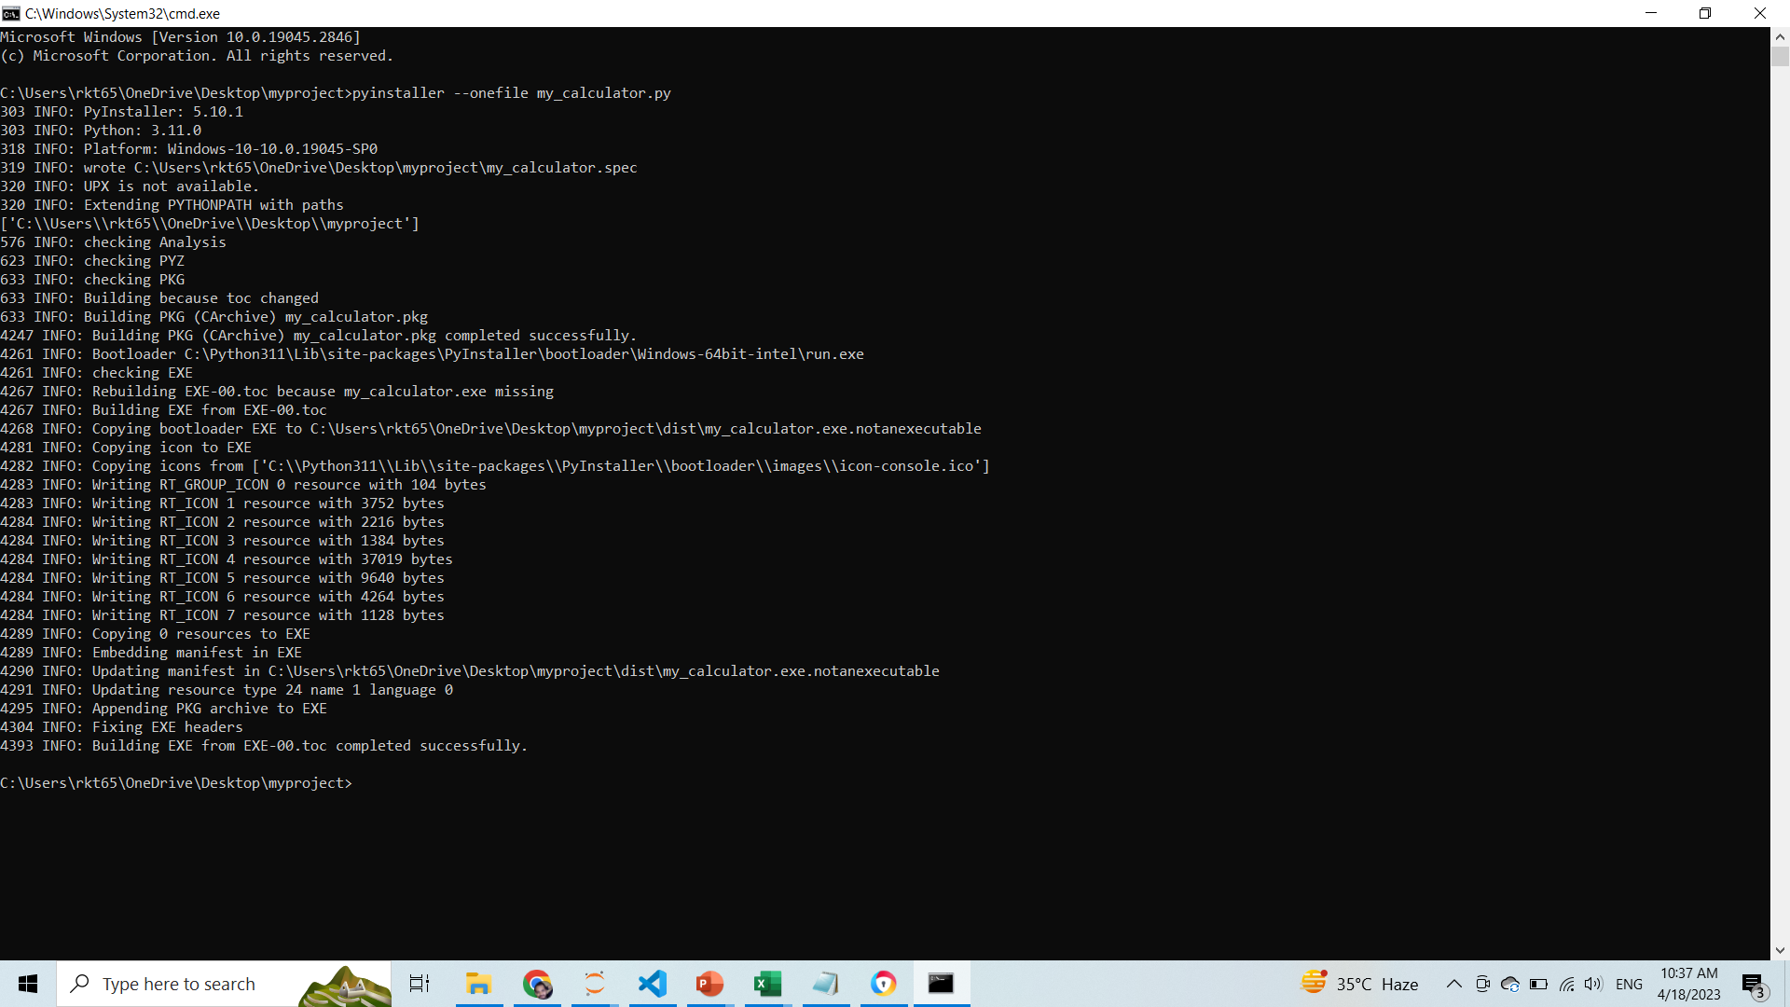
If you want to create online single file instead of these folders just type below command.

Slide 10
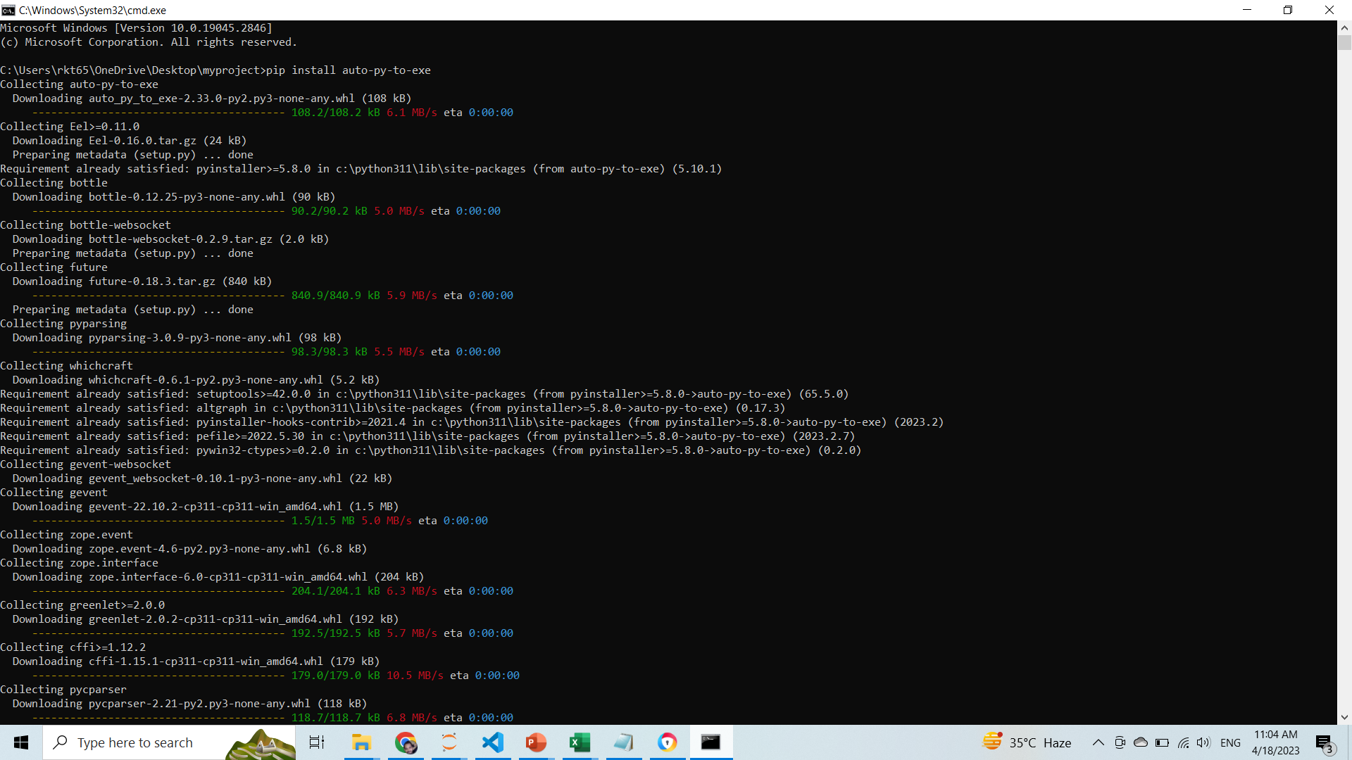
If we want to set icon on our .exe file we need another module (pip install auto-py-to-exe). First we need to install this module as you can see below……

Slide 11
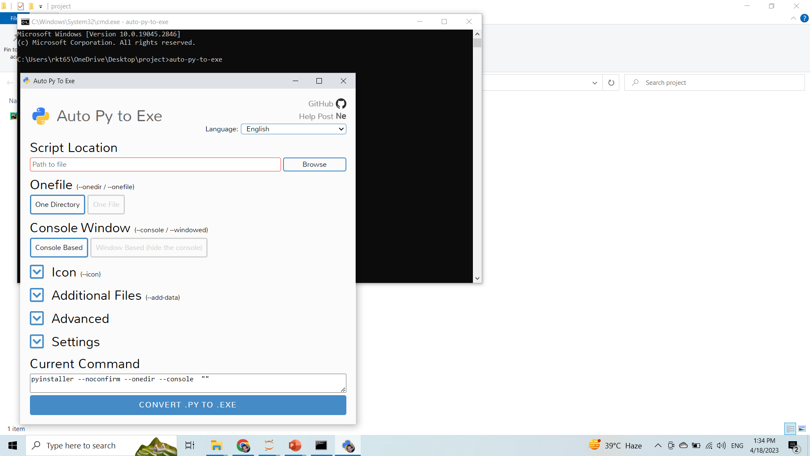
1.With the help of (auto-py-to-exe) module you can convert multiple .py files to .exe files. You can install this module buy command (pip install auto-py-to-exe) 2.Now open cmd in same folder in which you have your .py file. After that type (auto-py-to-exe) and hit Enter. 3.A new pop up window will open as below

Slide 12
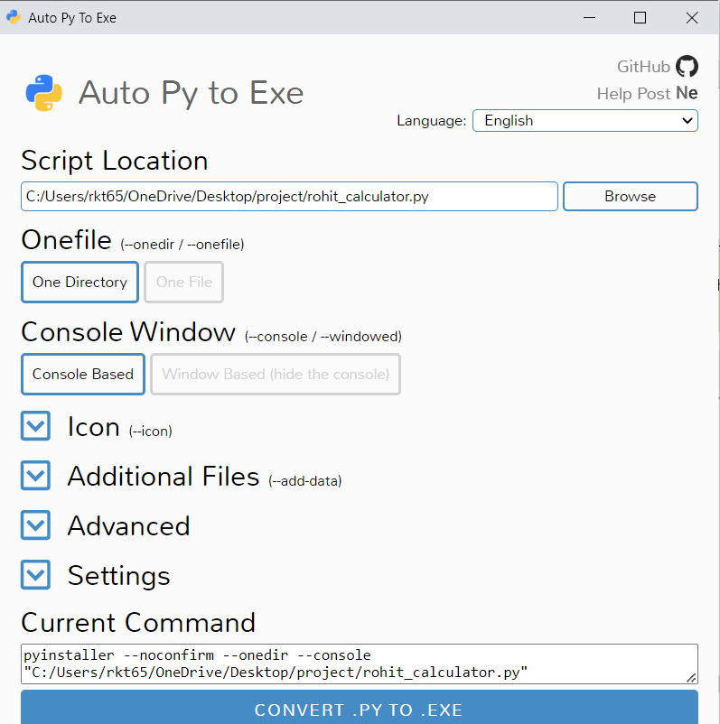
Now browse the path where you have your .py file

Slide 13
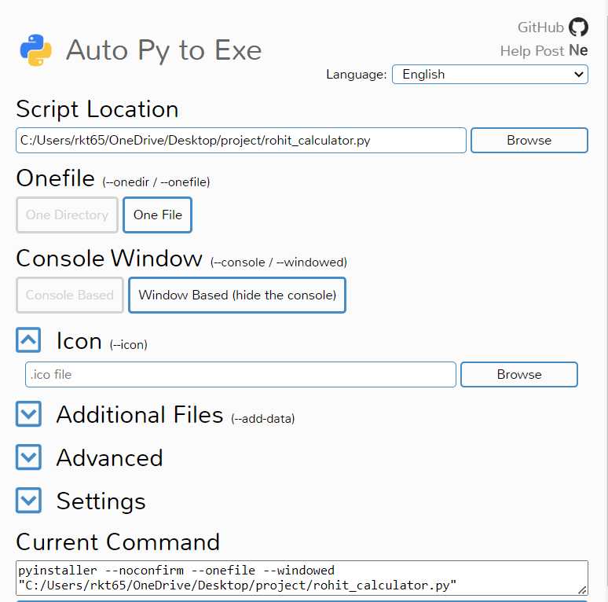
Now select your icon after browse the path.

Slide 14
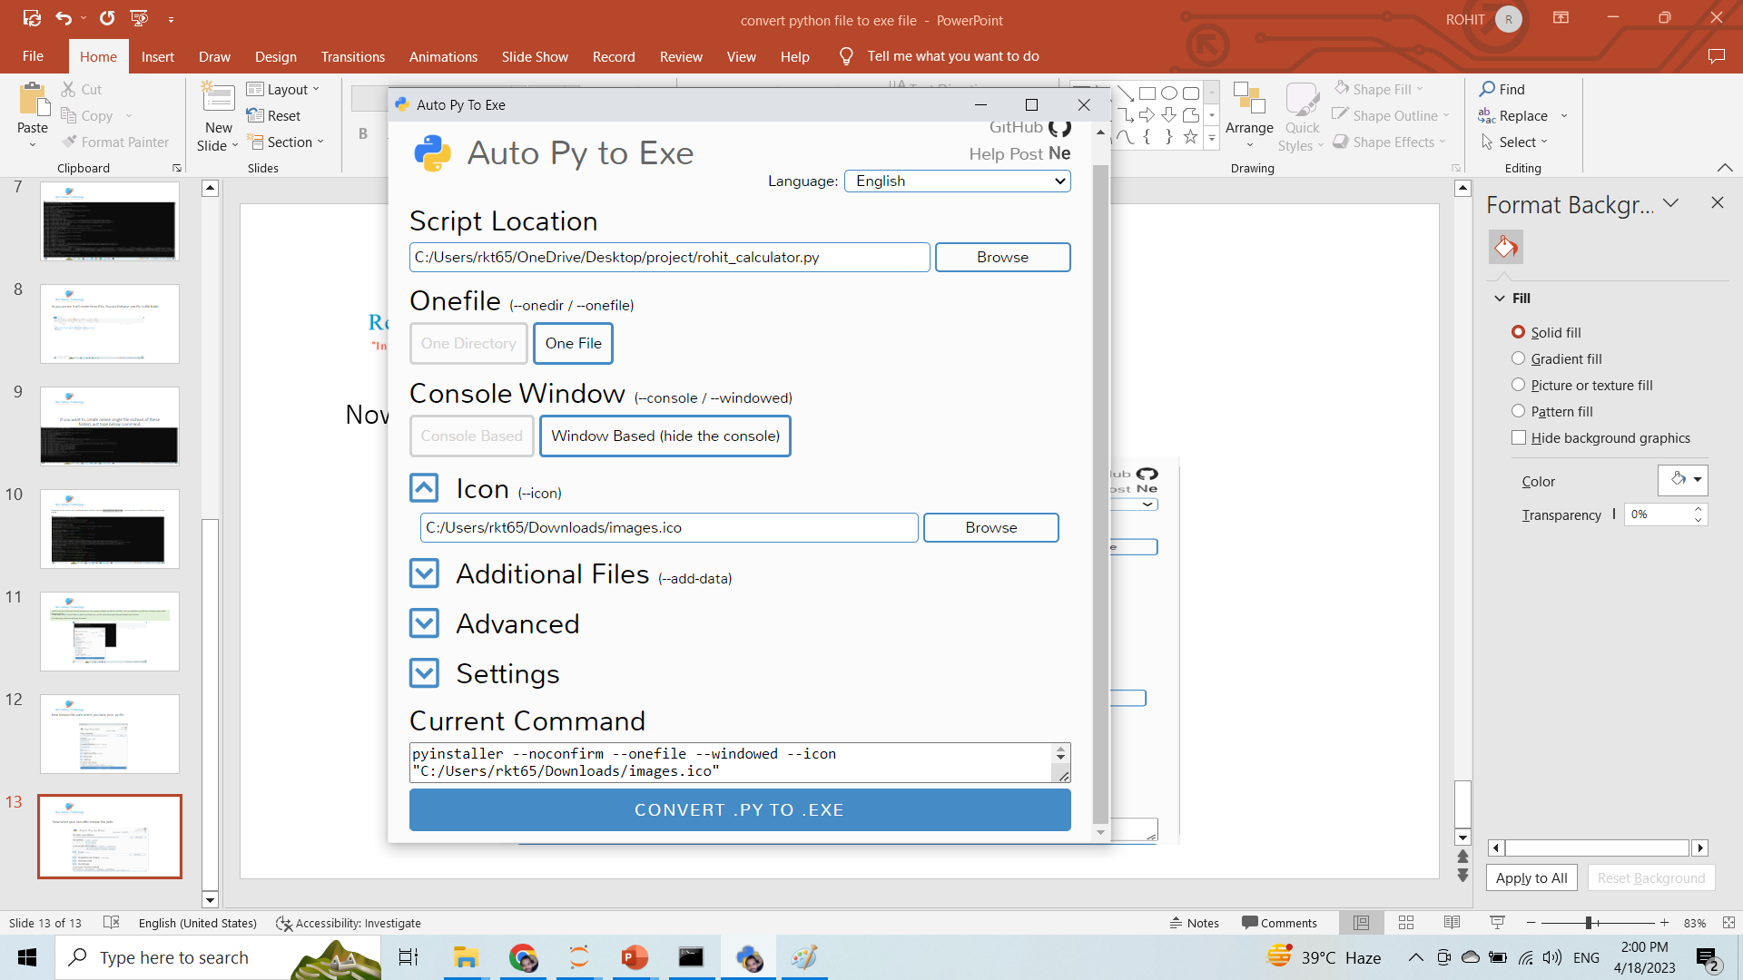
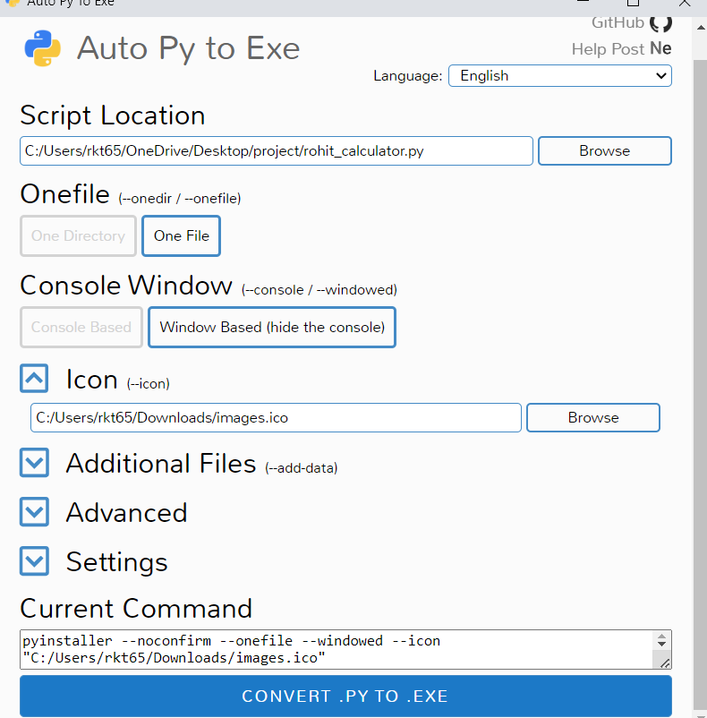
You image format should be .ico
We have selected the path
Now click on convert.py to .exe

Slide 15

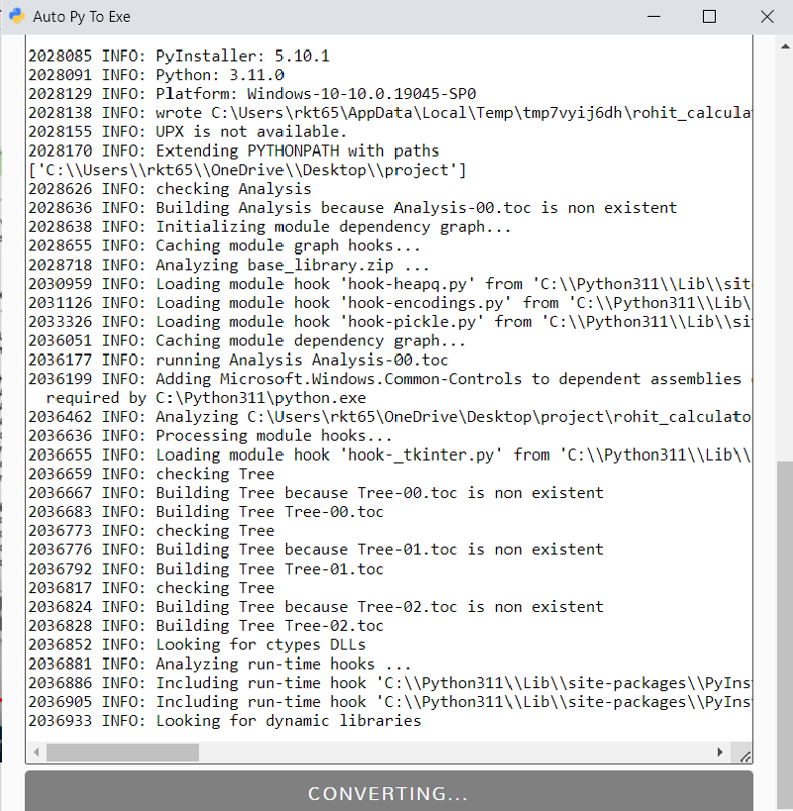
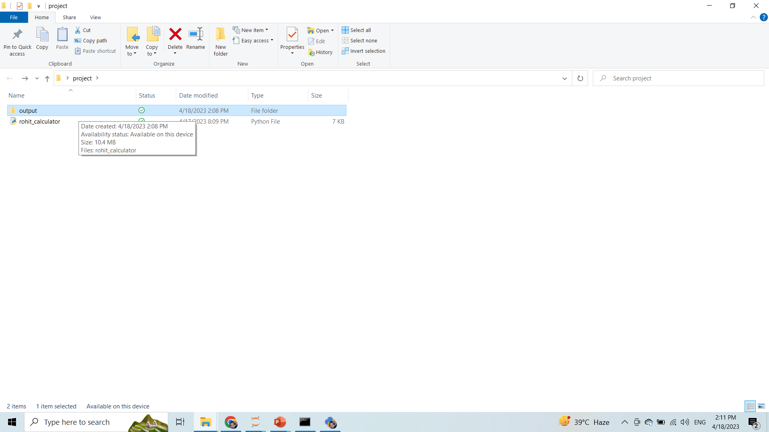
Your file will be converted to .py with icon. It will create a new folder named(output) and inside that folder you you will see your converted file with icon…..

